Slide 1
Web Services
By Vivek Gohil

Slide 2
Content
Section 1
Web Services – The Big Picture
SOA Concept
XML Standards
XML and XML Schema Definition

Slide 3
Section 1
SOA and Web Services

Slide 4
Web Service Introduction
What is web service?
SOAP, XML ,JSON
Consumer
Application
Provider Application
HTTP

Slide 5
Web Service Introduction
Advantages of Web Services
Interoperability
Loosely Coupled
Extensibility
Mashups

Slide 6
Web Service Introduction
Types of Web Services
SOAP
REST
XML
SOAP
HTTP POST
ALL HTTP Methods
REST
Multiple Data Formats

Slide 7
Web Service Introduction
Java Web Services Standards
Java Web Services
JAX-WS
SOAP
REST
JAX-RS

Slide 8
SOA
What SOA is ?
Why we need it ?
Who maintains the SOA standards ?
Why web services are such a key technology to implement SOA ?

Slide 9
SOA
What is SOA ?
SOA is a collection of architectural principles to design and implement our software applications in a such a way that they are composed of several services that have simple well defined interfaces and can use each other in loosely coupled manner.

Slide 10
SOA
Who maintains the SOA standards ?
It is maintained by open bodies like W3C and OASOS

Slide 11
SOA
What is a Service and Why we need it?
A service according to SOA is an implementation of business logic that operates independent of the state of an other service.
Appointment
Management
Doctor Service
Clinical Service
Patient
Service
Bed Management Service

Slide 12
SOA
Types of SOA Contracts in web services
SOAP
WSDL
REST
WADL

Slide 13
Advantages of SOA
Platform Independent
Focused Developer Roles
Loosely Coupled
Reusability
Cost Reduction
Scalability
Availability

Slide 14
SOA and Web Services
SOA which stands for Service Oriented Architecture is a set of principles.
Web services is a way to implement those principles in our applications that we create.

Slide 15
Quiz
SOA and Web Services one and the same?
True
False
Which of these are the benefits of SOA?
Flexibility and Scalability
Adaptability and Loose Coupling
Planform Independence
All the above

Slide 16
Section 2
XML and XML Schema Definition

Slide 17
Introduction to XML
What is XML ?
How to create XML document?
What well formedness is ?
How to define the contract for XML using XSD?
What namespaces are in XML ?

Slide 18
What is xml?
XML is stand for Extensible markup language.
XML dose not have any predefined set of elements(tags) , it allows us to create our own tags.

Slide 19
Examples
<OrderDetails>
<Order id="101">
<Qualntity>10</Qualntity>
<Price>4200</Price>
<ShippingAddress>B-212 , M.G. Road , Mumbai - 12</ShippingAddress>
</Order>
</OrderDetails>
<EmployeeDetails>
<Employee id="100">
<FirstName>Vivek</FirstName>
<LastName>Gohil</LastName>
<Designation>Developer</Designation>
<Salary>1000</Salary>
</Employee>
</EmployeeDetails>

Slide 20
Why XML?
Allow Developers To Create Custom Markup.
It carries both , Data and Metadata.
Supports Well-Formedness – To Get Clear XML File.
Allow application to do the validations using XML Schema Validation.

Slide 21
When/Where to create XML?
Data exchange between applications.
SOAP and Rest Web Service use for data exchange.
Setting configuration of application.
web.xml , server.xml , pom.xml , spring.xml
Save data and manipulate data , present data.
Withing the application using JAXB

Slide 22
What is XSD?
XSD stands for XML Schema Definition.
XSD defines the grammar or a blueprint for a XML document.
We can use the XSD to mention what elements can be there in a XML document.
Elements
Attributes
Namespaces can used
Order of elements
Number of Occurrences
Restrictions on data

Slide 23

XML and XSD
If XML follows the XSD then it is called as Valid XML document.
XSD is a also a XML file with .xsd extension.
All the elements that we can use inside a XSD file is defined by W3C.
XSD is used as a contract between two application which exchange the XML data.
validate
order.xml
order.xsd

Slide 24

XML Schema – Use Case
xml
Patient Billing
Patient Clinical
xsd
xsd
Validate Patient Data : Name , Age Dob , Email , Gender , Phone

Slide 25
XML Schema Hands On Using Eclipse
Creating complex type in XSD.
Patient.xsd
Patient.xml
<?xml version="1.0" encoding="UTF-8"?>
<schema xmlns="http://www.w3.org/2001/XMLSchema"
targetNamespace="http://www.borntocode.com/patient"
xmlns:tns="http://www.borntocode.com/patient"
elementFormDefault="qualified">
<element name="patient" type="tns:Patient" />
<complexType name="Patient">
<sequence>
<element name="id" type="int" />
<element name="name" type="string" />
<element name="age" type="int" />
<element name="dob" type="date" />
<element name="gender" type="string" />
<element name="email" type="string" />
</sequence>
</complexType>
</schema>
<?xml version="1.0" encoding="UTF-8"?>
<tns:patient xmlns:tns="http://www.borntocode.com/patient"
xmlns:xsi="http://www.w3.org/2001/XMLSchema-instance"
xsi:schemaLocation="http://www.borntocode.com/patient patient.xsd ">
<tns:id>1</tns:id>
<tns:name>Vivek</tns:name>
<tns:age>33</tns:age>
<tns:dob>2001-01-01</tns:dob>
<tns:gender>M</tns:gender>
<tns:email>ghl_vivek@hotmail.com</tns:email>
</tns:patient>

Slide 26
XML Schema Hands On Using Eclipse
How to use simple type and restrict the values of elements.
Patient.xsd
<?xml version="1.0" encoding="UTF-8"?>
<schema xmlns="http://www.w3.org/2001/XMLSchema"
targetNamespace="http://www.borntocode.com/patient"
xmlns:tns="http://www.borntocode.com/patient"
elementFormDefault="qualified">
<element name="patient" type="tns:Patient" />
<complexType name="Patient">
<sequence>
<element name="id" type="tns:ID" />
<element name="name" type="tns:String15Chars" />
<element name="age" type="int" />
<element name="dob" type="date" />
<element name="gender" type="tns:Gender" />
<element name="email" type="string" />
</sequence>
</complexType>
Simple Type Declaration
</schema>
<simpleType name="ID">
<restriction base="int">
<pattern value="[0-9]*" />
</restriction>
</simpleType>
<simpleType name="String15Chars">
<restriction base="string">
<maxLength value="15" />
</restriction>
</simpleType>
<simpleType name="Gender">
<restriction base="string">
<enumeration value="M" />
<enumeration value="F" />
</restriction>
</simpleType>

Slide 27
XML Schema Hands On Using Eclipse
Creating Complex type within complex type
<element name="patient" type="tns:Patient" />
<complexType name="Patient">
<sequence>
//unchanged xml code
<element name="payment" type="tns:PaymentType"></element>
</sequence>
</complexType>
<complexType name="PaymentType">
<choice>
<element name="cash" type="int" />
<element name="insureance" type="tns:Insurence" />
</choice>
</complexType>
<complexType name="Insurence">
<all>
<element name="provider" type="string" />
<element name="limit" type="int" />
</all>
</complexType>

Slide 28
XML Schema Hands On Using Eclipse
Controlling the number of Elements using minOccurs and maxOccurs
<complexType name="Patient">
<sequence>
<element name="id" type="tns:ID" />
<element name="name" type="tns:String15Chars" />
<element name="age" type="int" />
<element name="dob" type="date" />
<element name="gender" type="tns:Gender" minOccurs="0"/>
<element name="email" type="string" maxOccurs="2" />
<element name="phone" type="string" maxOccurs="unbounded" />
<element name="payment" type="tns:PaymentType"></element>
</sequence>
</complexType>

Slide 29
XML Schema Hands On Using Eclipse
Understand elementFormDefault
Qualified = compulsory to XML document to use namespace prefix
UnQualifed = prefix is not required

Slide 30
XML Schema Hands On Using Eclipse
Defining Attributes in XML
<element name="patient" type="tns:Patient" />
<complexType name="Patient">
<sequence>
<element name="name" type="tns:String15Chars" />
<element name="age" type="int" />
<element name="dob" type="date" />
<element name="gender" type="tns:Gender" minOccurs="0"/>
<element name="email" type="string" maxOccurs="2" />
<element name="phone" type="string" maxOccurs="unbounded" />
<element name="payment" type="tns:PaymentType"></element>
</sequence>
<attribute name="id" type="tns:ID"></attribute>
</complexType>

Slide 31
Section Summary
XML : Stands for extensible markup language.
It allows us to create custom elements or tags for use application.
The power of XML is comes from its data and METAdata.
XML is mainly used for two purposes.
To exchange information
As a configuration file
There are certain well formedness rules that every xml document should follow and we have learned about those rules
If xml file has a XML schema definition file or a XSD file and if that XML complaints or follows that XML schema it is called a valid XML.

Slide 32
Section Summary
The XML Schema definition or a XSD is a contract between XML and provider and consumer.
It is also the XML document which uses elements defined by W3C.
We use the inbuilt types come up with our SimpleTypes and ComplextTypes.
We have also learnt about namespaces which uniquely quantify the elements in our XML or xml schemas.
We have created the XML file and also validated it using XSD file.

Slide 33
Quiz
What is the root element of a schema file?
xsd:complextype
xsd:schema
xsd:root
xsd:element
Which element in XML Schema can be used to restrict values?
xsd:regularexpression
xsd:condition
xsd:restriction
xsd:sequence

Slide 34
Quiz
Which of the following ensures the order in which the xml elements should occur?
xsd:sequence
xsd:choice
xsd:all
xsd:order
Which two schema attributes can be used to control the number of XML element occurrences?
minOccurs and maxOccurs
loweBound and upperBound
min and max
minNum and maxNum

Slide 35
SOAP Web Services Concepts

Slide 36
Introduction
In this section we will understand what , Why and When to SOAP web services in your application.
Also various advantages and disadvantages of SOAP web-services.
The building blocks of SOAP web-services mainly SOAP , WSDL and HTTP.
Will wrap it up by mastering the various sections of a WSDL file.

Slide 37
Web Services
Web Services are Simply Awesome!
Web Services are to the software world what English to this planet. They are common ground or language.

Slide 38

Web Application VS Web Services
Web Application
HTTP Request
HTML Response
Web Browser
Web Application

Slide 39
Web Application VS Web Services
Web Service
HTTP Request
XML / JSON Response
Web Application OR
Web Service
Web Application
OR
Web Service

Slide 40
What Is Web Service?
Web Services are a set of technologies and rules that enable two or more components on the web to talk to each other.

Slide 41
The First Web Service – SOAP
WSDL
Service description using WSDL
Response using WSDL
WSDL Query
XML Service request based on WSDL
XML Service Response based on WSDL
Service Provider
Service Consumer

Slide 42
Why we need Web Services?
Platform Independent
HTTP – Transport Independent
XML – Data Independent
Distributed Programming
The need to allow components on the web to talk to each other and interoperate.
The web is now a very large and interlinked set of systems.
Better User Experience
Cloud Computing

Slide 43
Limitations/Cons of using Web Services – SOAP
Performance impact due to serialization and deserialization of SOAP messages.

Slide 44
When to use SOAP Web Services ?
We should use the SOAP based web services when the formal contract needs to be established to describe the interface that the web service offers.
We can do this using WSDL Document.

Slide 45
What is SOAP?
SOAP stands for Simple Object Access Protocol.
It is a specification from W3C ( World Wide Web Consortium).
Current version of SOAP is 1.2
A Specification usually is a set of rules.
In case of SOAP these rules come in form of a XML document.

Slide 46
SOAP – XML Document Structure
<soap:envelope>
<!-- soap header is used to send meta information -->
<soap:header>
<!-- soap body where the request and response payload -->
<soap:body>
<!-- request payload -->
<creditcard>
<!-- Credit Card Details -->
</creditcard>
<!-- In Case Any Exception Occurs -->
<soap:fault>
<soap:code></soap:code>
<soap:reason>
<soap:text> Card Expired <soap:text>
</soap:reason>
</soap:fault>
</soap:body>
</soap:header>
</soap:envelope>

Slide 47
WSDL File Explained
WSDL File
WSDL file is a contract between the web service provider and the consumer.
It is a XML file with a dot wsdl (.wsdl) extenstion.
Example : userProfile.wsdl

Slide 48
WSDL File Explained
What WSDL file provides ?
It tells what this particular webservice provides.
How it provides. (What message a consumer should send in the request)
How to consume these web service. (What response will go back)

Slide 49
WSDL File Explained
WSDL File is divided two parts
Abstract Portion
Which tells what this webservice provides.
Physical Portion
How to consume this webservice.
definitions
types
messages
Abstract Portion
porttype
operation
binding
Physical Portion
service

Slide 50
WSDL File Explained
Sample WSDL Files
UserProfile.wsdl – Files shared on github
UserProfile.xsd – Files shared on github

Slide 51
WSDL File Explained : Abstract Portion
<wsdl:types>
<xsd:schema targetNamespace="http://borntocode.com/userProfile" elementFormDefault="qualified">
<xsd:import namespace="http://borntocode.com/userProfile/schema/UserProfile.xsd" schemaLocation="UserProfile.xsd"/>
<xsd:element name="GetUserProfile">
<xsd:complexType>
<xsd:sequence>
<xsd:element name="userName" type="xsd:string"/>
</xsd:sequence>
</xsd:complexType>
</xsd:element>
<xsd:element name="GetUserProfileResponse">
<xsd:complexType>
<xsd:sequence>
<xsd:element name="UserProfile" type="upSchema:UserProfile"/>
</xsd:sequence>
</xsd:complexType>
</xsd:element>
</xsd:schema>
</wsdl:types>
types
<wsdl:message name="GetUserProfileRequest">
<wsdl:part name="params" element="tns:GetUserProfile"/>
</wsdl:message>
<wsdl:message name="GetUserProfileResponse">
<wsdl:part name="result" element="tns:GetUserProfileResponse"/>
</wsdl:message>
messages
Abstract Portion
operation
<wsdl:portType name="UserProfilePortType">
<wsdl:operation name="GetUserProfile">
<wsdl:input message="tns:GetUserProfileRequest"/>
<wsdl:output message="tns:GetUserProfileResponse"/>
</wsdl:operation>
</wsdl:portType>
porttype

Slide 52
WSDL File Explained : Physical Portion
<wsdl:binding name="UserProfileBinding" type="tns:UserProfilePortType">
<soap:binding style="document" transport="http://schemas.xmlsoap.org/soap/http"/>
<wsdl:operation name="GetUserProfile">
<soap:operation soapAction="urn:GetUserProfile"/>
<wsdl:input>
<soap:body use="literal"/>
</wsdl:input>
<wsdl:output>
<soap:body use="literal"/>
</wsdl:output>
</wsdl:operation>
</wsdl:binding>
binding
Physical Portion
<wsdl:service name="UserProfileService">
<wsdl:port binding="tns:UserProfileBinding" name="UserProfilePort">
<soap:address location="http://localhost/services/UserProfileService"/>
</wsdl:port>
</wsdl:service>
service

Slide 53
WSDL Binding Styles
RPC and encoded
RPC and literal
Document and encoded
Document and literal
Note : RPC is nothing to do with Java Remote Procedure Call.

Slide 54
RPC and encoded (RPC/encoded)
Java Method
If we create/generate the WSDL file for the given method
public void myMethod(int x, float y);
<message name="myMethodRequest">
<part name="x" type="xsd:int"/>
<part name="y" type="xsd:float"/>
</message>
<message name="empty"/>
<portType name="PT">
<operation name="myMethod">
<input message="myMethodRequest"/>
<output message="empty"/>
</operation>
</portType>
<binding .../>

Slide 55
RPC and encoded (RPC/encoded)
SOAP Request Body
<soap:envelope>
<soap:body>
<myMethod>
<x xsi:type="xsd:int">5</x>
<y xsi:type="xsd:float">5.0</y>
</myMethod>
</soap:body>
</soap:envelope>

Slide 56
RPC and encoded (RPC/encoded)
Advantages
The WSDL is about as straightforward as it is possible for a WSDL to be.
The operation name appears in the message, so the receiver has an easy time dispatching this message to the implementation of the operation.
Disadvantages
You cannot easily validate this message since only the
<x ...="">5</x> and <y ...="">5.0</y> lines contain things defined in a schema; the rest of the soap:body content comes from WSDL definitions.
The type encoding information (such as xsi:type="xsd:int") can degrade throughput performance.
Although it is legal WSDL, RPC encoded is not WS-I compliant.

Slide 57
RPC and Literal (RPC/literal)
Java Method
If we create/generate the WSDL file for the given method
public void myMethod(int x, float y);
<message name="myMethodRequest">
<part name="x" type="xsd:int"/>
<part name="y" type="xsd:float"/>
</message>
<message name="empty"/>
<portType name="PT">
<operation name="myMethod">
<input message="myMethodRequest"/>
<output message="empty"/>
</operation>
</portType>
<binding .../>
<!-- I won't bother with the details, just assume it's RPC/literal. -->

Slide 58
RPC and Literal (RPC/literal)
SOAP Request Body
<soap:envelope>
<soap:body>
<myMethod>
<x>5</x>
<y>5.0</y>
</myMethod>
</soap:body>
</soap:envelope>

Slide 59
RPC and Literal (RPC/literal)
Advantages
The WSDL is still about as straightforward as it is possible for WSDL to be.
The operation name still appears in the message.
The type encoding info is eliminated.
RPC/literal is WS-I compliant.
Disadvantages
You still cannot easily validate this message since only the <x ...>5</x> and <y ...>5.0</y> lines contain things defined in a schema; the rest of the soap:body contents comes from WSDL definitions.

Slide 60
Document/encoded
Nobody follows this style. It is not WS-I compliant. So let’s move on.

Slide 61
Document and literal (Document/literal)
Java Method
If we create/generate the WSDL file for the given method
public void myMethod(int x, float y);
<types>
<schema>
<element name="xElement" type="xsd:int"/>
<element name="yElement" type="xsd:float"/>
</schema>
</types>
<message name="myMethodRequest">
<part name="x" element="xElement"/>
<part name="y" element="yElement"/>
</message>
<message name="empty"/>
<portType name="PT">
<operation name="myMethod">
<input message="myMethodRequest"/>
<output message="empty"/>
</operation>
</portType>
<binding .../>

Slide 62
RPC and Literal (RPC/literal)
SOAP Request Body
<soap:envelope>
<soap:body>
<xElement>5</xElement>
<yElement>5.0</yElement>
</soap:body>
</soap:envelope>

Slide 63
RPC and Literal (RPC/literal)
Advantages
There is no type encoding info.
You can finally validate this message with any XML validator. Everything within the soap:body is defined in a schema.
Document/literal is WS-I compliant, but with restrictions (see Weaknesses)..
Disadvantages
The WSDL is getting a bit more complicated. This is a very minor weakness, however, since WSDL is not meant to be read by humans.

Slide 64
SOAP Web Services Design
Top Down or WSDL First or Contract First
Code First or Bottom Up

Slide 65
Top Down or WSDL First or Contract First
First we create the WSDL file.
Generate the java stubs using tools like wsdl2java
Implement the web service endpoint.

Slide 66
Top Down or WSDL First or Contract First
Advantages
Contract with the consumer signed off
Better Interoperability
Faster Integration

Slide 67
Code First Design
Write Java Code and Annotate
Generate WSDL from the code using java2wsdl

Slide 68
Code First Design
Advantages
We can integrate the legacy application

Slide 69
Which design to choose?
Contract first except while exposing legacy applications as web services.

Slide 70
JAX-WS
JAX-WS standards for Java API for XML based Web Services.
JAX-WS
Specification
API
Web Services Engines
Annotations
Apache CXF
GlassFish

Slide 71
Important Annotations To Implement WS
@javax.jws.WebService
@javax.jws.WebMethod
@javax.jws.WebParam(name = <paramName>)
@javax.jws.WebResult(name = <resultName>)
@javax.xml.ws.WebFault
@javax.jws.soap.SOABinding(style=<style>,use=<use>
@javax.xml.ws.RequestWrapper
@javax.xml.ws.ResponseWrapper

Slide 72
JAXB
Java API for XML Binding.
It provides an easy way to map Java classes to XML schema.
Java
JAXB
XML

Slide 73
Generate Java Classes From XML Schema
Create New Maven Project
Create Schema File or use existing files
Use Maven JAXB Plugin
Do the Marshalling(Java to XML) and Unmarshalling(XML to Java) of java classes.

Slide 74
Apache CXF
Apache CXF is the powerful and popular web services engine in java space because it implements both JAXWS and JAXRS.
Using Apache CXF we can develop both the webservice provider and web service consumer.

Slide 75
Why Apache CFX?
Apache CFX comes with a SOAP and REST engine which at the minimum does two things.
Accept XML message and convert XML message into a java object and pass the java object to the appropriate method on the webservice endpoint.
Takes the response from the web service class method and converts it back into xml and sends back to client.
Implements all the Web Service Standards
WS-Security
WS-Policy

Slide 76
Create a SOAP Web Service
Create the project using Spring Initializr (https://star.spring.io)
Create the endpoint : CustomerOrdersImpl.java class
Create the config class : WebServiceConfig.java class
Run the application.

Slide 77
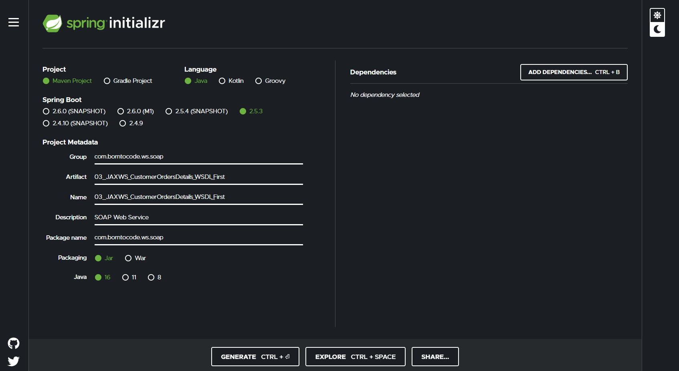
Create the project using Spring Initializr
https://start.spring.io/

Slide 78
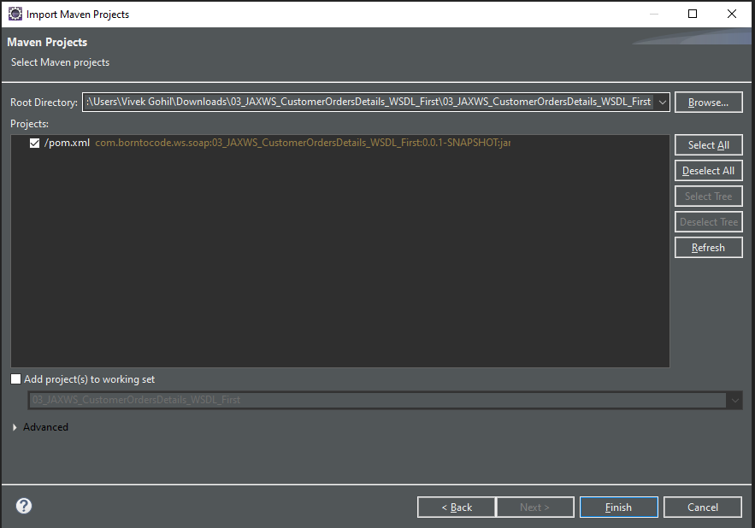
Create the project using Spring Initializr
Extract the project and import in eclipse as existing maven project

Slide 79
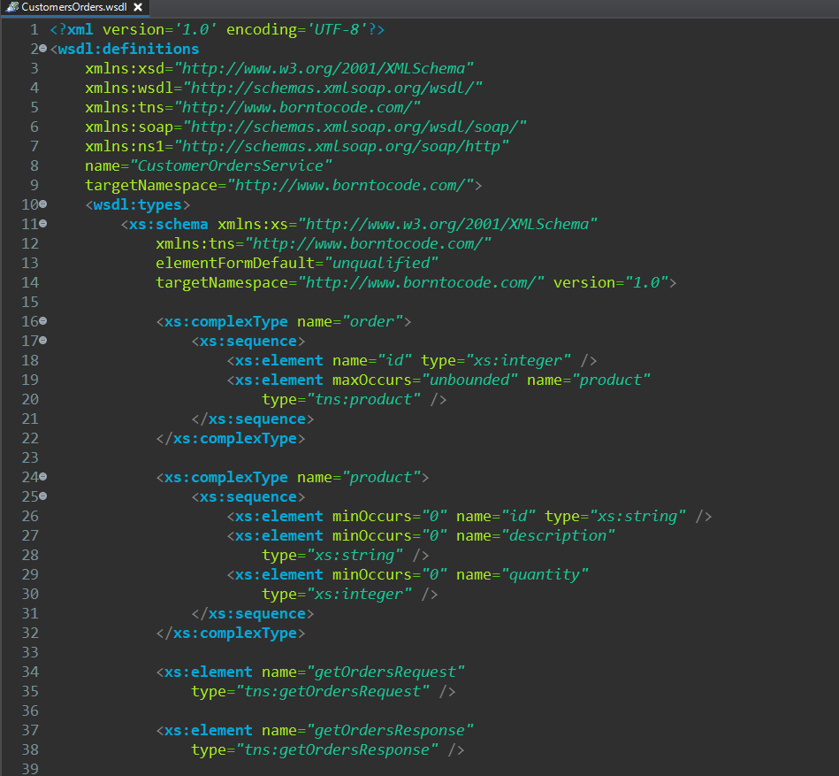
Create the project using Spring Initializr
Create new wsdl file as CustomerOrders.wsdl in src/main/resources folder.

Slide 80
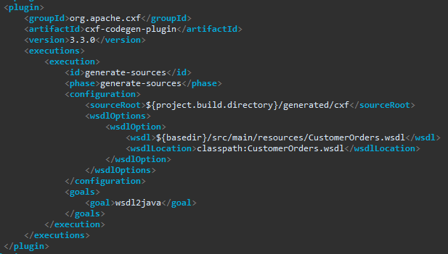
Create the project using Spring Initializr
Open pom.xml file and configure the plugin to generate stub(Java Classes) from WSDL file.
Update the maven project after adding plugin.

Slide 81
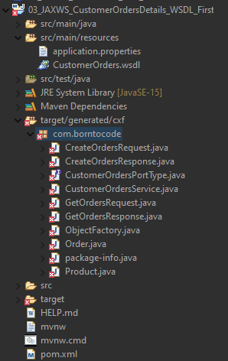
Create the project using Spring Initializr
We are getting error in generated classes.

Slide 82
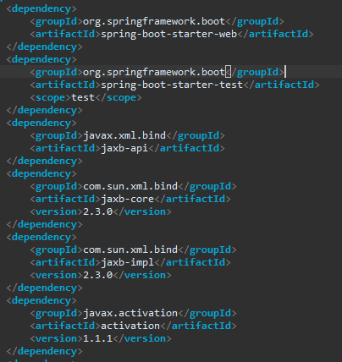
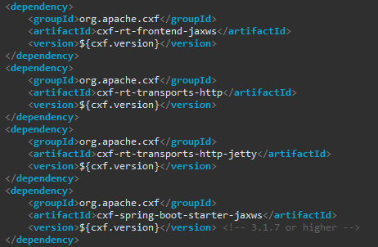
Create the project using Spring Initializr
To resolve these errors add below listed maven dependencies.

Slide 83
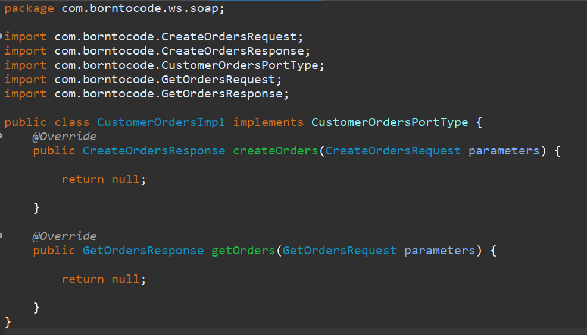
Create the endpoint : CustomerOrdersImpl class

Slide 84
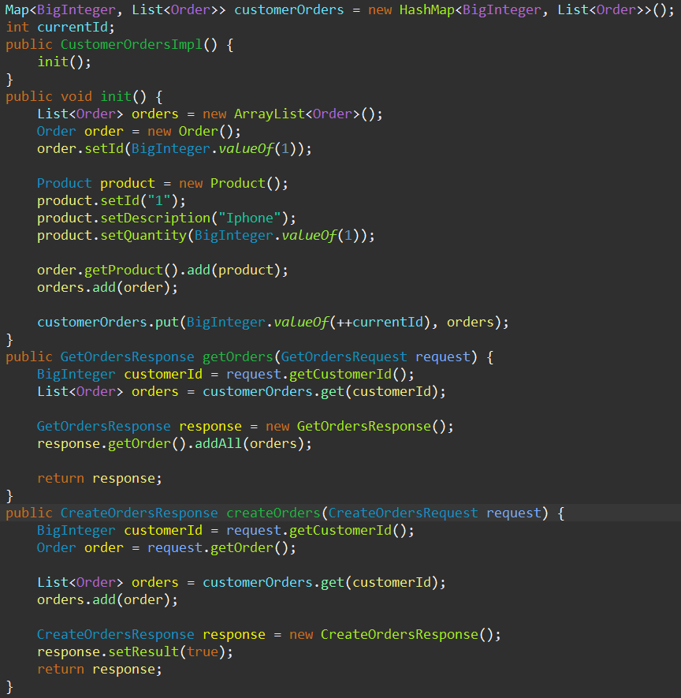
Create the endpoint : CustomerOrdersImpl class

Slide 85
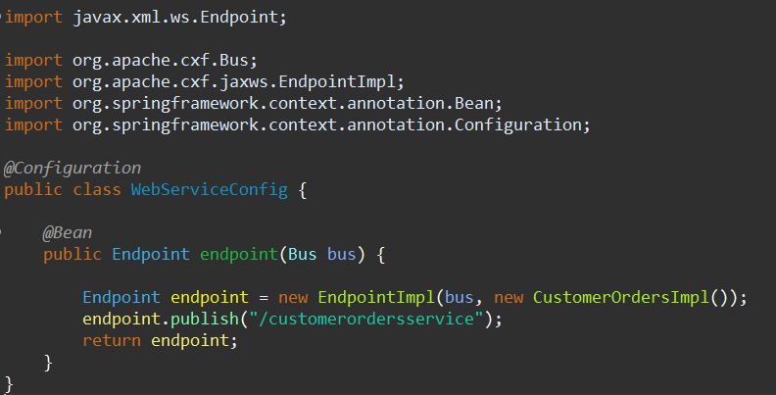
Create the config class : WebServiceConfig.java

Slide 86
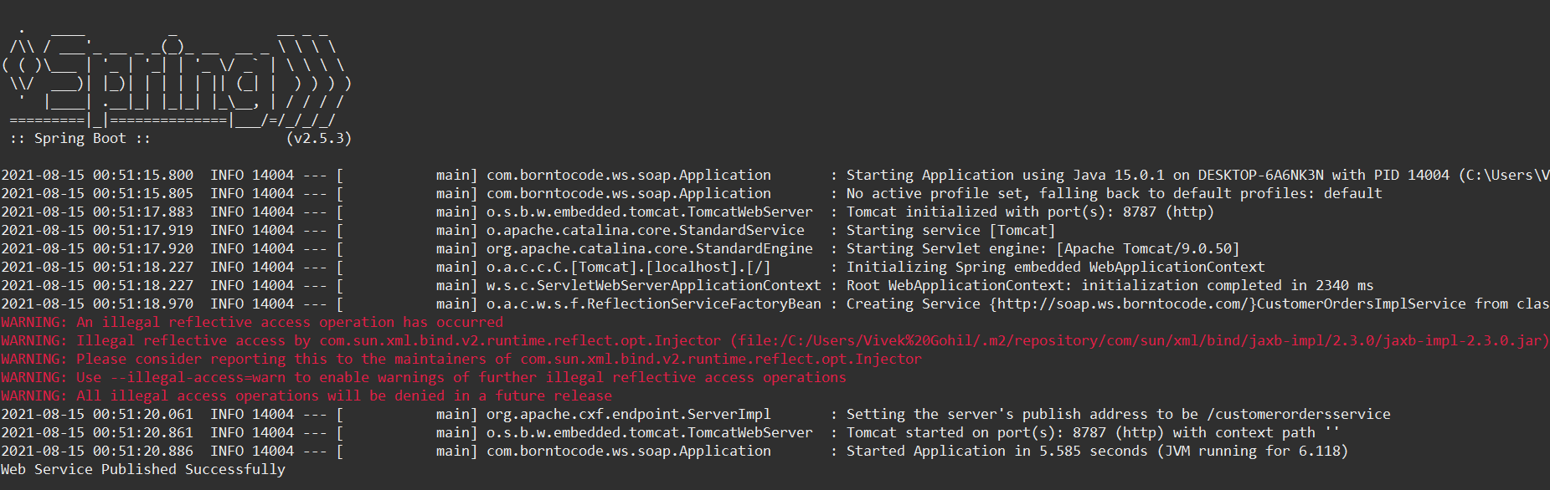
Run the application

Slide 87
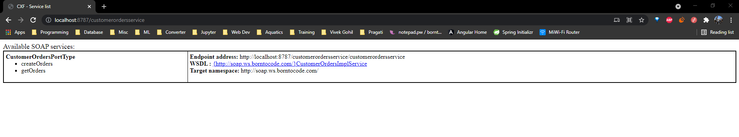
Run the application
http://localhost:8787/customerordersservice

Slide 88
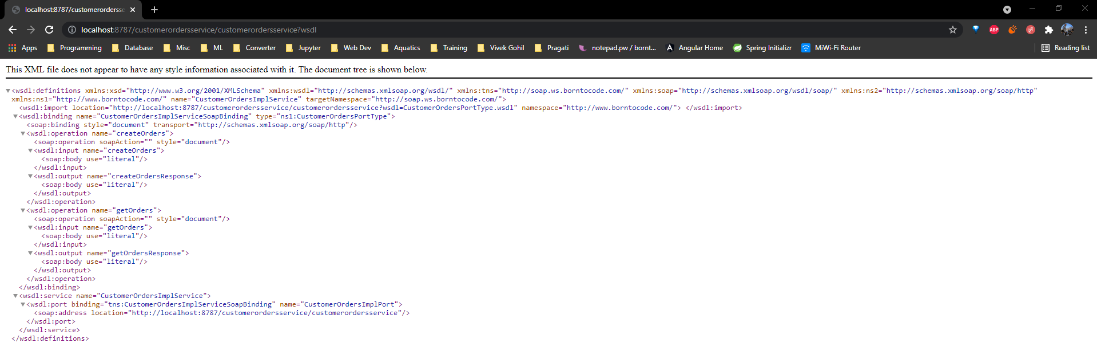
Check WSDL File
http://soap.ws.borntocode.com/}CustomerOrdersImplService

Slide 89
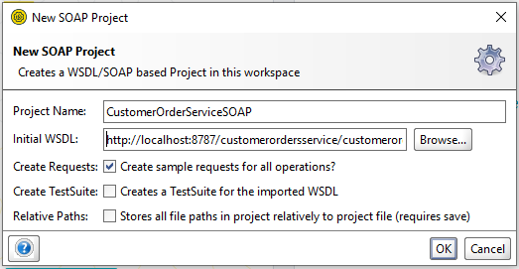
Test CustomersOrderService using SOAPUI
Select New SOAP Project and give project name and Initial WSDL URL.

Slide 90
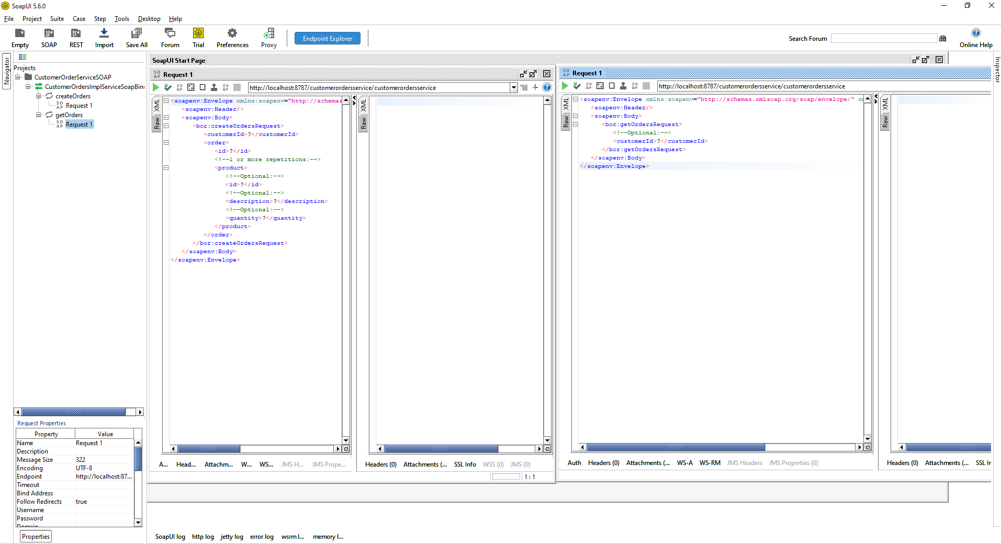
Test createOrder and getOrders methods

Slide 91
Assignment
Add delete order functionality in our CustomerOrdersService.

Slide 92
Java SOAP Client
Create New Project
Copy the WSDL
Generate the stubs/Source code
Create CustomerOrderWSClient class
Run the application

Slide 93
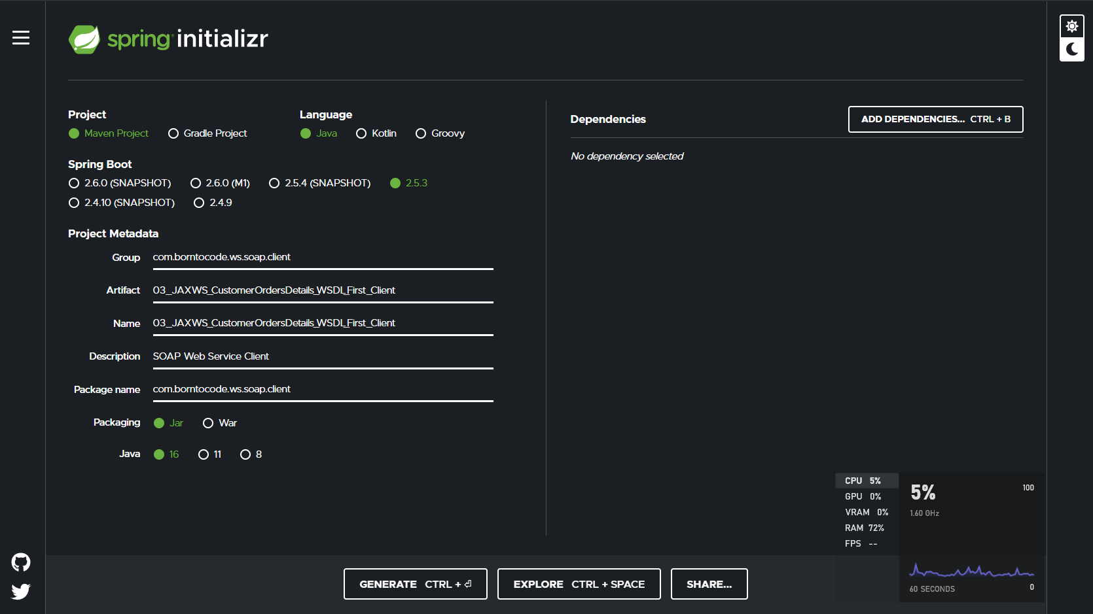
Create New Project Using Spring Initializr

Slide 94
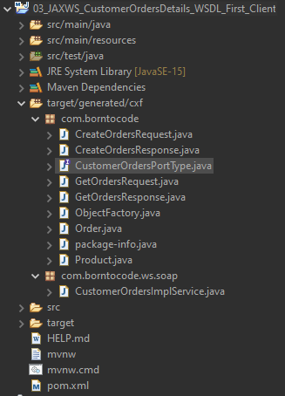
Copy the WSDL & Generate the stubs/Source code
Copy the WSDL file from the deployed SOAP web service and copy WSDL file in resources folder.
Add plugin to generate source codes

Slide 95
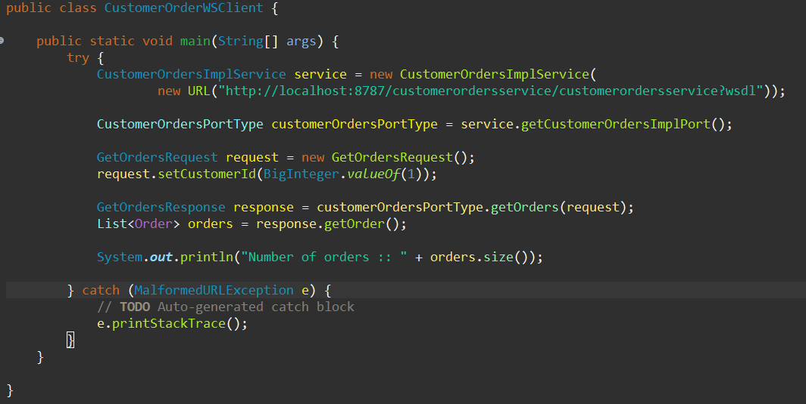
Create CustomerOrderWSClient Class

Slide 96
Run the application
Check the output

Slide 97
Java First Web Service Development Approach
Create a Dynamic Web Application
Mark Business logic with JAXB and JAX-WS annotations.
Create a configuration class
Run the application

Slide 98
Assignment
Create client for the Java First web service

